Slide 1
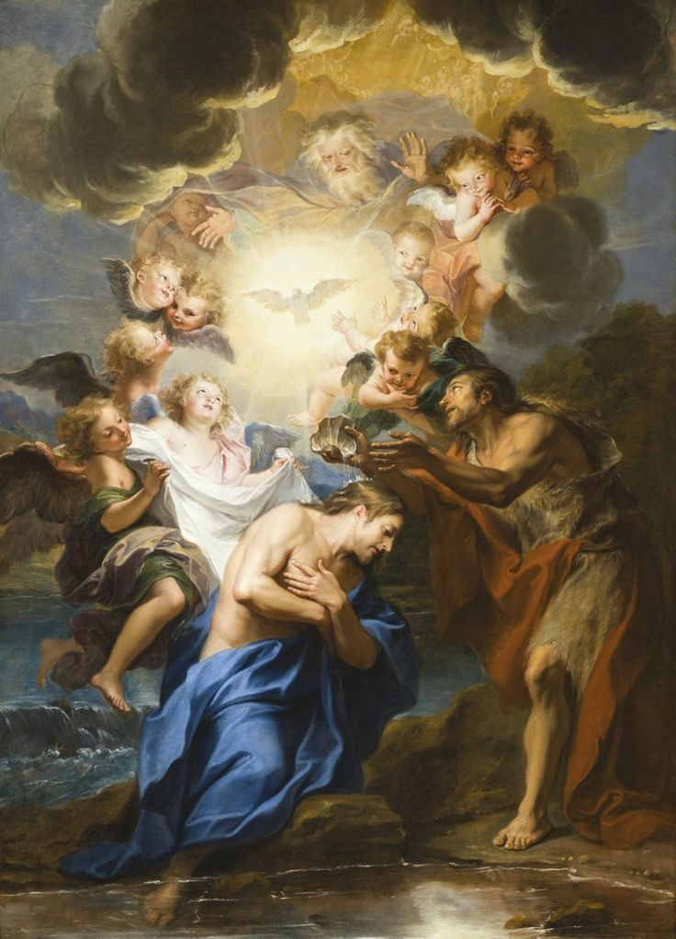
Baptism
St. Mary Cathedral

Slide 2
Business
Sign-in Sheet
Bathrooms
Water
Children

Slide 3
Come Holy Spirit, fill the hearts of your faithful and kindle in them the fire of your love. Send forth your Spirit, and they shall be created and You shall renew the face of the earth.
O, God, who by the light of the Holy Spirit, did instruct the hearts of the faithful, grant that by the same Holy Spirit we may be truly wise and ever enjoy His consolations. Through Christ Our Lord. Amen.

Slide 4
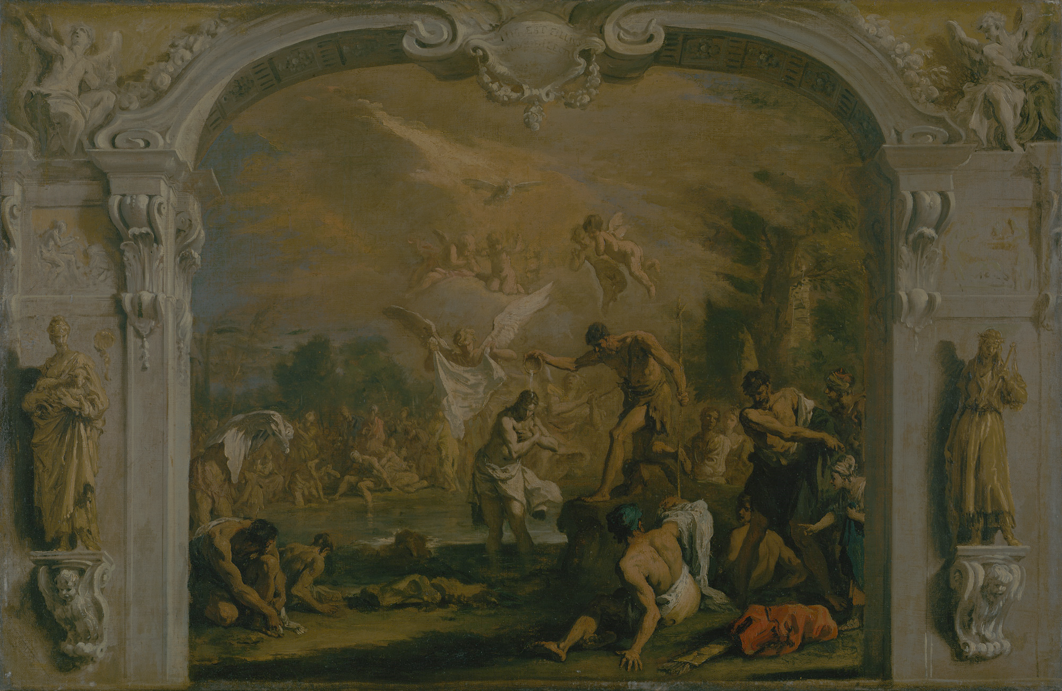

Introduction

Slide 5
Why Are We Here?
This is a big deal (no really, it is)
God, The Church giving your child a HUGE gift
The Bishop wants to make sure it’s done right and everyone understands its import
It’ll help you grow in Faith
It’ll help me grow in Faith

Slide 6
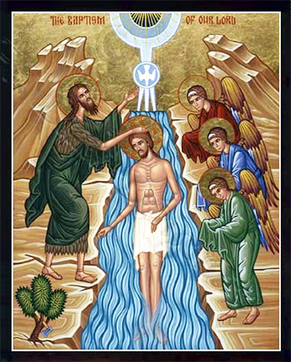
What is Baptism?
Greek βαπτίζω “baptizô”; “Immerse” and “Perform Ablution”: Washing.
The first of the Sacraments of the Church
Holy Water and the Trinitarian Formula
Burial, death, resurrection and rebirth
Established Exultate Deo (Pope Eugene IV 1439), Council of Florence, Council of Trent

Slide 7
Descriptions of Baptism
Most precious gift
Grace (gratuitous)
Anointing
Enlightenment
Garment of Immortality
Bath of rebirth
Seal
CCC 1216

Slide 8
Why do we do Baptism?
Prefigured in Old Testament (Creation, Deluge, Exodus -- 1 Peter 3:20-21)
Christ taught us, died for us, then commanded us (CCC 1223, Mt 28:19-20; cf. Mk 16:15-16.)
Saving grace, removes Original Sin – not a just a symbol, it has REAL power (Mark 5:27-34)
Necessary for Salvation (1 Pt 3:21, John 3):
“Unless a man be born again of water and the Holy Spirit, he can not enter into the kingdom of God.”
(CCC 1257 – Necessity of Baptism)
Notes:
Mt 28:19-20; cf. Mk 16:15-16.
1 Peter 3:20-21
… God patiently waited in the days of Noah during the building of the ark, in which a few persons, eight in all, were saved through water.21This prefigured baptism, which saves you now. It is not a removal of dirt from the body but an appeal to God ⁷ for a clear conscience, through the resurrection of Jesus Christ,
Mark 5: 27-34
he had heard about Jesus and came up behind him in the crowd and touched his cloak.28⁹ She said, "If I but touch his clothes, I shall be cured."29Immediately her flow of blood dried up. She felt in her body that she was healed of her affliction.30Jesus, aware at once that power had gone out from him, turned around in the crowd and asked, "Who has touched my clothes?"31But his disciples said to him, "You see how the crowd is pressing upon you, and yet you ask, 'Who touched me?'"32And he looked around to see who had done it.33The woman, realizing what had happened to her, approached in fear and trembling. She fell down before Jesus and told him the whole truth.34He said to her, "Daughter, your faith has saved you. Go in peace and be cured of your affliction."

Slide 9
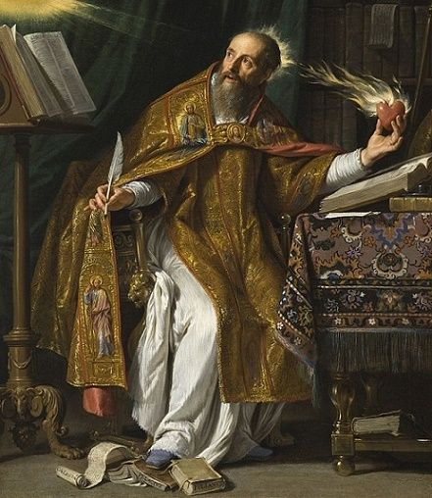
Easter Exsúltet
What good would life have been to us, had Christ not come as our Redeemer? Father, how wonderful your care for us! How boundless your merciful love! To ransom a slave you gave away your Son. O happy fault (felix culpa), O necessary sin of Adam, which gained for us so great a Redeemer!

Slide 10
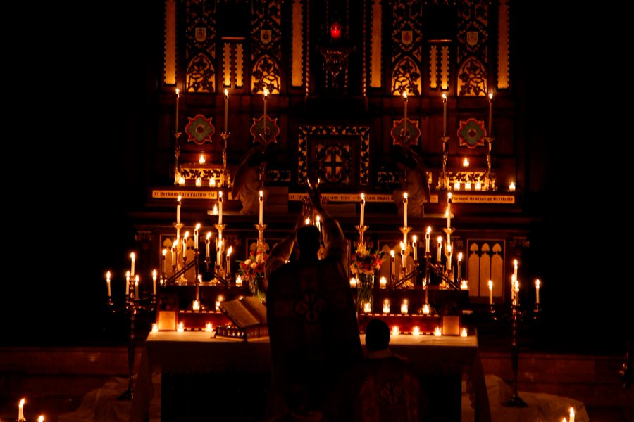
What is a Sacrament?
Outward Sign of Inward Grace
Faith!
Indelible Mark
Minister
Matter
Form
Effects
Intention

Slide 11
Effects of Baptism
Remission of all sin, original and actual
Remission of temporal punishment
Right to be called “Christian”
Inclusion in the Church
Infusion of supernatural grace, gifts, and virtues
Right to special graces
Impression of a character upon the soul

Slide 12
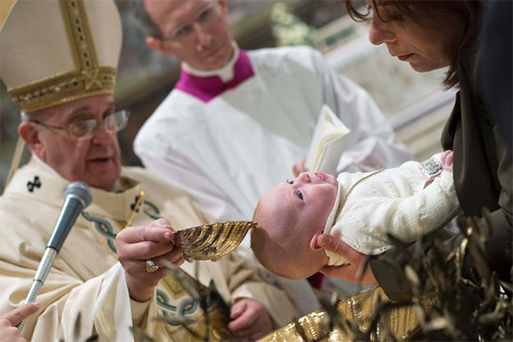
Who can Baptize?
Ordinary Ministers (ordained Bishop, Priest, Deacon in good standing and with licit orders)
In necessity, anyone (even non-Baptized people) provided they have the correct intention and do the Trinitarian Formula correctly

Slide 13
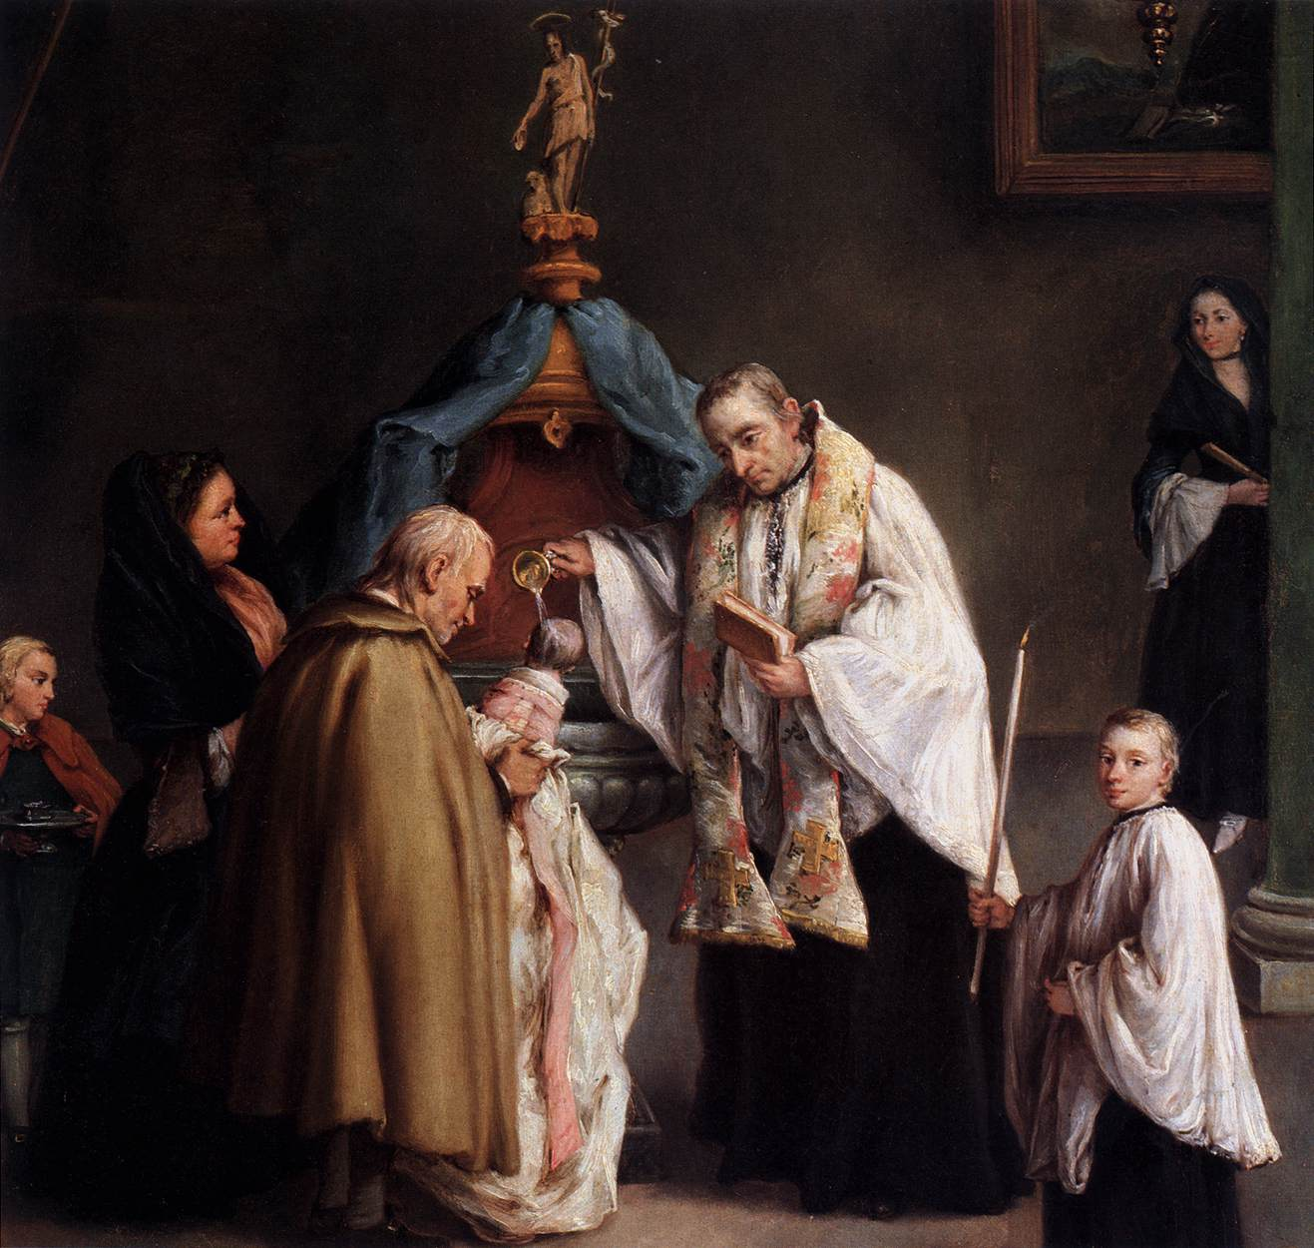
Who can be Baptized?
Adults
Born Infants (or those with permanent mental impairment)
Partially born or in-utero (conditionally)
Foundlings (conditionally)
Notes:
(Matthew 19:14): "Suffer the little children, and forbid them not to come to me: for the kingdom of heaven is for such." It has been objected that this latter text does not refer to infants, inasmuch as Christ says "to come to me". In the parallel passage in St. Luke (18:15), however, the text reads: "And they brought unto him also infants, that he might touch them"; and then follow the words cited from St. Matthew. In the Greek text, the words brephe and prosepheron refer to infants in arms.
Moreover, St. Paul (Colossians 2) says that baptism in the New Law has taken the place of circumcision in the Old. It was especially to infants that the rite of circumcision was applied by Divine precept. If it be said that there is no example of the baptism of infants to be found in the Bible, we may answer that infants are included in such phrases as: "She was baptized and her household" (Acts 16:15); "Himself was baptized, and all his house immediately" (Acts 16:33); "I baptized the household of Stephanus" (1 Corinthians 1:16).

Slide 14
Who can NOT (generally) be Baptized?
Children without parental consent
Children of consenting non-Catholic parents (Jewish, Protestant, etc)
The dead
Notes:
(Matthew 19:14): "Suffer the little children, and forbid them not to come to me: for the kingdom of heaven is for such." It has been objected that this latter text does not refer to infants, inasmuch as Christ says "to come to me". In the parallel passage in St. Luke (18:15), however, the text reads: "And they brought unto him also infants, that he might touch them"; and then follow the words cited from St. Matthew. In the Greek text, the words brephe and prosepheron refer to infants in arms.
Moreover, St. Paul (Colossians 2) says that baptism in the New Law has taken the place of circumcision in the Old. It was especially to infants that the rite of circumcision was applied by Divine precept. If it be said that there is no example of the baptism of infants to be found in the Bible, we may answer that infants are included in such phrases as: "She was baptized and her household" (Acts 16:15); "Himself was baptized, and all his house immediately" (Acts 16:33); "I baptized the household of Stephanus" (1 Corinthians 1:16).

Slide 15
Why Children?
Because Christ says it’s necessary for everyone
Because we believe God sincerely wants everyone to be saved.
Because in Luke 18 Christ says “suffer the little children”, and they brought infants so He could touch them
Because in Acts (16) and 1 Corinthians, whole households were baptized
Church Fathers taught this, Church Councils declared it doctrine
Notes:
Origen (in cap. vi, Ep. ad Rom.) declares: "The Churchreceived from the Apostles the tradition of giving baptism also to infants".
St. Augustine (Serm. xi, De Verb Apost.) says of infant baptism: "This the Church always had, always held; this she received from the faith of our ancestors; this she perseveringly guards even to the end."
St. Cyprian (Epistle 58) writes: "From baptism and from grace . . . must not be kept the infant who, because recently born, has committed no sin, except, inasmuch as it was born carnally from Adam, it has contracted the contagion of the ancient death in its first nativity; and it comes to receive the remission ofsins more easily on this very account that not its own, but another's sins are forgiven it."
St.Cyprian's letter to Fidus declares that the Council of Carthage in 253 reprobated the opinion that the baptism of infants should be delayed until the eighth day after birth.
The Council of Milevis in 416 anathematizes whosoever says that infants lately born are not to be baptized.
The Council of Trent solemnly defines the doctrine of infant baptism (Sess. VII, can. xiii). It also condemns (can. xiv) the opinion of Erasmus that those who had been baptized in infancy, should be left free to ratify or reject the baptismal promises after they had become adult.

Slide 16
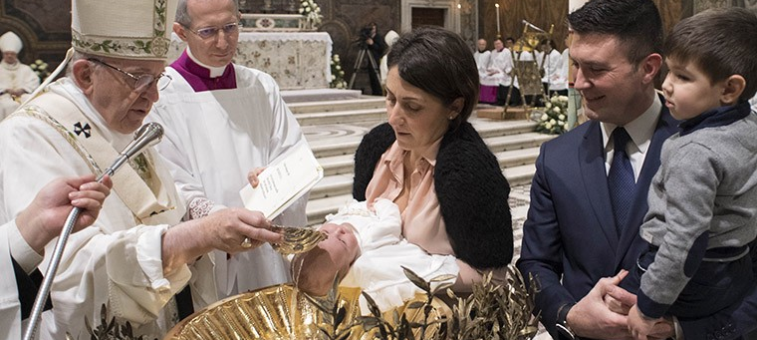
The Rite of Baptism for Children

Slide 17
What’s in a Name?
Handing oneself over to be accessible and capable of being known more intimately (CCC 203)
“God calls each one by name. Everyone's name is sacred. The name is the icon of the person. It demands respect as a sign of the dignity of the one who bears it.” (CCC 2158)

Slide 18
Request of the Parents
“What do you ask of God’s Church?”

Slide 19
(Aside) Godparents, Sponsors, Witnesses
Why Godparents? Canon 872
Who can be a Godparent? Canon 873
What about non-Catholics? Canon 874
Witnesses? Canon 875
Notes:
Can. 872 In so far as possible, a person being baptised is to be assigned a sponsor. In the case of an adult baptism, the sponsor’s role is to assist the person in christian initiation. In the case of an infant baptism, the role is together with the parents to present the child for baptism, and to help it to live a christian life befitting the baptised and faithfully to fulfil the duties inherent in baptism.
Can. 873 One sponsor, male or female, is sufficient; but there may be two, one of each sex.
Can. 874 §1 To be admitted to undertake the office of sponsor, a person must:
1° be appointed by the candidate for baptism, or by the parents or whoever stands in their place, or failing these, by the parish priest or the minister; to be appointed the person must be suitable for this role and have the intention of fulfilling it;
2° be not less than sixteen years of age, unless a different age has been stipulated by the diocesan Bishop, or unless the parish priest or the minister considers that there is a just reason for an exception to be made;
3° be a catholic who has been confirmed and has received the blessed Eucharist, and who lives a life of faith which befits the role to be undertaken;
4° not labour under a canonical penalty, whether imposed or declared;
5° not be either the father or the mother of the person to be baptised.
§2 A baptised person who belongs to a non-catholic ecclesial community may be admitted only in company with a catholic sponsor, and then simply as a witness to the baptism.
Chapter V : PROOF AND REGISTRATION OF BAPTISM
Can. 875 Whoever administers baptism is to take care that if there is not a sponsor present, there is at least one witness who can prove that the baptism was conferred.
The following are some non-Catholic Churches without valid baptisms: · Apostolic Church · Bohemian Free Thinkers · Christadelphians · Christian Community (Rudolf Steiner) · Christian Scientists · Church of Divine Science
· Church of God · Jehovah’s Witnesses · Masons (no baptism at all) · Mormons · Church of the New Jerusalem · Pentecostal churches · Peoples Church of Chicago · Quakers · Salvation Army · Unitarians The following are some non-Catholic Churches that have valid baptisms: · All Eastern non-Catholics (Orthodox) * · Adventists · African Methodist Episcopal · Amish · Anglican · Assembly of God · Baptists · Christian and Missionary Alliance · Church of the Brethren · Congregational Church · Disciples of Christ · Episcopalians · Evangelical United Brethren · Evangelical Churches · Liberal Catholic Church · Lutherans · Methodists · Church of the Nazzerine · Old Catholics · Old Roman Catholics · Polish National Church · Presbyterian Church · Reformed Churches · United Church of Christ

Slide 20
Query of the Godparents
Spiritual Adoption
Covenant (BIG DEAL!)
Raise them up, or drag them down
Responsibility on your conscience
Remember this day!
Teach them in the Sacraments

Slide 21
Claim for Christ, Sign of the Cross
Minister, Parents, Godparents
“The sign of the cross strengthens us in temptations and difficulties.” (CCC 2157)
Like warrior paint, outward sign of spiritual combat (St. Thomas Aquinas)

Slide 22
Gospel Reading
Usually Mark 1:9-11, but there are others that can be used
Christ didn’t need Baptism: Not necessary, but fitting
Holy Spirit descends like a dove
Indwelling of the Holy Trinity

Slide 23
General Intercessions
We implore God to impart His Graces to the child

Slide 24
Small Litany of the Saints
We implore the Holy Saints to also pray and implore God for Graces.

Slide 25
Simple Exorcism
Not a “Solemn” (aka “Major”) Exorcism
Part of removing the effects of Original Sin
Concupiscence remains
See “Christian Faith and Demonology” by the CDF (1975)

Slide 26
Anointing on Breast
Cleansing and Strengthening
“Oil of Catechumens” – Blessed Holy Thursday (or Tuesday)
“To be protected from evil” – Christian Faith and Demonology

Slide 27
Blessing of the Water
Reminds us of the many prefigurements of Baptism in the Old Testament
Celebrant actually touches water, God no longer hovers over the water, He is in it
“…buried with Christ … rise also with him”

Slide 28
Renunciation of Sin, Profession of Faith
Reminder of responsibility for child
Renewal of your own vows of Baptism and Confirmation
Rejection of evil; “and all his works”
Confirmation of the Faith
Prevents incompatibilities with non-Christians
Commitment to the Church
“I do” is an oath, a sworn promise

Slide 29
The Baptism
One last final check “Is it your will…”
Full or partial immersion

Slide 30
Explanatory Rites

Slide 31
Anointing After Baptism
Anointed Priest, Prophet and King
Uses “Sacred Chrism”, blessed on Holy Thursday (or Tuesday) by the Bishop
Bishop breathed on the oil, like Christ breathed on the Apostles

Slide 32
Anointing: Priest
Three types: High, Ministerial, Family
Priests pay homage to God for the society through sacrifice
Family priests can offer little sacrifices of suffering for grace

Slide 33
Anointing: Prophet
Proclaims the Gospel, the truth of God
Receives the 7 Gifts of the Holy Spirit
Fear of the Lord, Piety, Knowledge, Fortitude, Right Counsel, Understanding, Wisdom (CCC 1831)

Slide 34
Anointing: King
Covenant in sharing in Christ’s kingdom
Members of the new Kingdom of Israel (the Church)
Grow and tend the Kingdom on Earth, prepare for the Kingdom of Heaven
Rule through service, reign through obedience, Conquer through love

Slide 35
Clothing of the White Garment
“put on Christ”
Risen with Christ

Slide 36
Lighting of Candle from Easter Candle
Light of Christ in the world
Enlightenment of soul and mind

Slide 37
Ephphetha
Can now hear and proclaim the Word of God
Isaiah 35:4-6: “Then will the eyes of the blind be opened, the ears of the deaf be cleared”
Mark 7:33-5: “[Jesus] said to him, ‘Ephphetha!’ (that is, ‘Be opened!’) And (immediately) the man's ears were opened, his speech impediment was removed, and he spoke plainly.”
Notes:
Mark 7: 33-35: He put his finger into the man's ears and, spitting, touched his tongue;
then he looked up to heaven and groaned, and said to him, "Ephphatha!" (that is, "Be opened!") And (immediately) the man's ears were opened, his speech impediment was removed, and he spoke plainly.
Isaiah 35: 4-6: Say to those whose hearts are frightened: Be strong, fear not! Here is your God, he comes with vindication; With divine recompense he comes to save you.
Then will the eyes of the blind be opened, the ears of the deaf be cleared;
Then will the lame leap like a stag, then the tongue of the dumb will sing. Streams will burst forth in the desert, and rivers in the steppe.

Slide 38
Conclusion, Prayer, Final Blessing
Now, in the only Son, a child of God entitled to pray the prayer of the children of God: Our Father.
Last pleas to Christ, the Blessed Mother, and all the Saints to watch over and guide this child and all of us into holy, Christ-like lives

Slide 39
VIDEO

Slide 40
U.S. Bishop’s Teachings
(reading from US Catechism)

Slide 41
Other forms of Baptism

Slide 42
Baptism of Blood

Slide 43
Baptism of Desire

Slide 44
CONCERNING Other FAITH Traditions

Slide 45
The Trinitarian Formula

Slide 46
Pseudo-Christian and non-Christian

